Slide 1


CSCE 692 Design Principles of Computer Architecture Lecture 4c Chap 3
Speculation
Multiple-Issue Architectures
Limits to ILP
Thread Level Parallelism
Dr. Scott Graham
AFIT/ENG
Notes adapted from
David Patterson
Electrical Engineering and Computer Sciences
University of California, Berkeley

Slide 2
Speculative Execution
Hardware Speculation: issue instructions based on branch predictions, but be ready to deal with consequences of mis-predicted branches, including exceptions occurring in mis-predicted code (“HW undo”)
called “boosting”
Combine branch prediction with dynamic scheduling to execute branches before resolved
Separate speculative bypassing of results from real bypassing of results
When instruction no longer speculative, write boosted results (instruction commit) or discard boosted results
Key: Execute out-of-order but commit in-order to prevent irrevocable action (update state or exception)

Slide 3
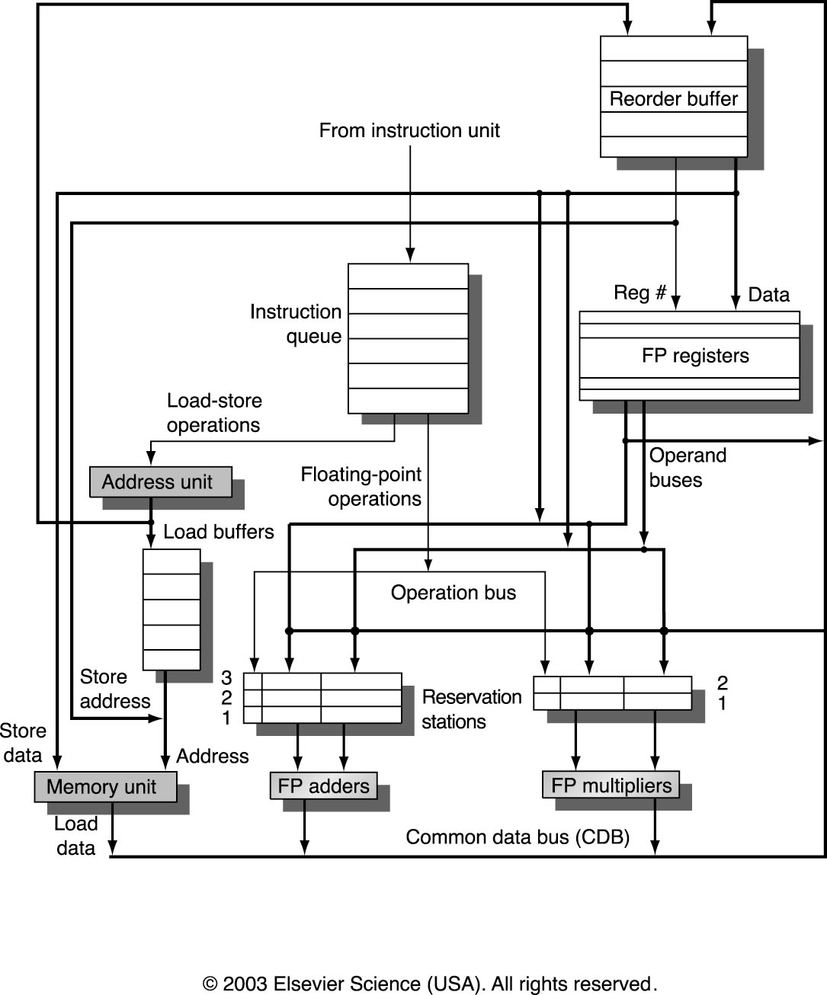
HW support for More ILP
Need HW buffer for results of uncommitted instructions: reorder buffer
Sometimes called Register Update Unit (RUU)
4 fields: instr type, destination, value, ready
Reorder buffer also an operand source like RS are
Use reorder buffer number instead of register file when execution completes
Supplies operands between execution complete & commit
Once operand commits, result is put into register
Instructions commit in order
As a result, its easy to undo speculated instructions on mispredicted branches or on exceptions

Slide 4
Four Steps of Speculative Tomasulo Algorithm
1. Issue—get instruction from FP Op Queue
If reservation station and reorder buffer slot free, issue instr & send operands & use reorder buffer no. for destination (this stage sometimes called “dispatch”)
2. Execution—operate on operands (EX)
When both operands ready then execute; if not ready, watch CDB for result; when both in reservation station, execute; checks RAW (sometimes called “issue”)
3. Write result—finish execution (WB)
Write on Common Data Bus to all awaiting FUs & reorder buffer; mark reservation station available.
4. Commit—update register with reorder result
When instr. at head of reorder buffer & result present, update register with result (or store to memory) and remove instr from reorder buffer. Mispredicted branch flushes reorder buffer. Correctly predicted branches are finished (sometimes called “graduation”).
Flush all or part of reorder buffer on mispredicted branch?

Slide 5
Avoiding Memory Hazards
WAW and WAR hazards through memory are eliminated with speculation because actual updating of memory occurs in order, when a store is at head of the ROB, and hence, no earlier loads or stores can still be pending
RAW hazards through memory are maintained by two restrictions:
not allowing a load to initiate the second step of its execution if any active ROB entry occupied by a store has a Destination field that matches the value of the A field of the load, and
maintaining the program order for the computation of an effective address of a load with respect to all earlier stores.
These restrictions ensure that any load that accesses a memory location written to by an earlier store cannot perform the memory access until the store has written the data

Slide 6
Exceptions and Interrupts
IBM 360/91 invented “imprecise interrupts”
Computer stopped at this PC; its likely close to this address
Not so popular with programmers
Also, what about Virtual Memory? (Not in IBM 360)
Technique for both precise interrupts/exceptions and speculation: in-order completion and in-order commit
If we speculate and are wrong, need to back up and restart execution to point at which we predicted incorrectly
This is exactly same as need to do with precise exceptions
Exceptions are handled by not recognizing the exception until instruction that caused it is ready to commit in ROB
If a speculated instruction raises an exception, the exception is recorded in the ROB
This is why reorder buffers in all new processors

Slide 7
Tomasulo with Speculation
Reservation Stations
Name Busy Op Vj Vk Qj Qk Dest
Add1 No
Add2 No
Add3 No
Mult1 No MUL.D Mem[45+Regs[R3]] Regs[F4] #3
Mult2 Yes DIV.D ROB[#3] Mem[34+Regs[R2]] #5
Reorder Buffer
Entry Busy Instruction State Destination Value
1 No L.D F6, 34(R2) Commit F6 Mem[34+Regs[R2]]
2 No L.D F2, 45(R3) Commit F2 Mem[45+Regs[R3]]
3 Yes MUL.D F0,F2,F4 Write Result F0 #2 x Regs[R4]
4 Yes SUB.D F8,F6,F2 Write Result F8 #1-#2
5 Yes DIV.D F10,F0,F6 Execute F10 #3 / M[R2+34]
6 Yes ADD.D F6,F8,F2 Write Result F6 #4+#2
FP Register Status
Field F0 F2 F4 F6 F8 F10 F12 F14 F16 F18 F20 F22 … F30
Reorder # 3 6 4 5
Reorder Yes No No Yes Yes Yes No No No No No No No
Busy
Why haven’t SUB.D and ADD.D committed?
What would happen if MUL.D throws an exception?

Slide 8
Getting CPI < 1: Issuing Multiple Instructions/Cycle
Superscalar: varying no. instructions/cycle (1 to 8), scheduled by compiler or by HW (Tomasulo)
(Very) Long Instruction Words (V)LIW: fixed number of instructions (4-16) scheduled by the compiler; put ops into wide templates
Style: “Explicitly Parallel Instruction Computer (EPIC)”
Anticipated success led to use of Instructions Per Clock cycle (IPC) vs. CPI
So what?

Slide 9
Multiple-Issue Processors
Common Name | Issue Structure | Hazard Detection | Scheduling | Distinguishing Characteristics | Examples
Superscalar (static) | Dynamic | Hardware | Static | In-order execution | Mostly embedded (MIPS & ARM)
Superscalar (dynamic) | Dynamic | Hardware | Dynamic | Some out-of-order execution | IBM Power2
Superscalar (speculative) | Dynamic | Hardware | Dynamic with speculation | Out-of-order execution with speculation | Intel Core i3, i5, i7 IBM Power7
VLIW | Static | Software | Static | No hazards between issue packets | Trimedia i860 (mostly embedded)
EPIC | Primarily Static | Primary Software | Mostly static | All hazards explicitly det. by compiler | Itanium

Slide 10
Statically Scheduled Issue
Superscalar MIPS: assume 2 instrs, 1 FP & 1 anything else
– Fetch 64-bits/clock cycle; Int on left, FP on right
– Can only issue 2nd instruction if 1st instruction issues
– More ports for FP registers to do FP load & FP op in a pair
Type Pipe Stages
Int. instruction IF ID EX MEM WB
FP instruction IF ID EX MEM WB
Int. instruction IF ID EX MEM WB
FP instruction IF ID EX MEM WB
Int. instruction IF ID EX MEM WB
FP instruction IF ID EX MEM WB

Slide 11
Loop Unrolling in Superscalar
Integer instruction FP instruction Clock cycle
Loop: L.D F0,0(R1) 1
L.D F6,-8(R1) 2
L.D F10,-16(R1) ADD.D F4,F0,F2 3
L.D F14,-24(R1) ADD.D F8,F6,F2 4
L.D F18,-32(R1) ADD.D F12,F10,F2 5
S.D 0(R1),F4 ADD.D F16,F14,F2 6
S.D -8(R1),F8 ADD.D F20,F18,F2 7
S.D -16(R1),F12 8
S.D -24(R1),F16 9
DADDI R1,R1,-40 10
BNEZ R1,LOOP 11
S.D 8(R1),F20 12
Unrolled 5 times to avoid delays
12 clocks, or 2.4 clocks per iteration (1.5x improvement over scalar example)

Slide 12
Multiple Issue Challenges
While Integer/FP split is simple for the HW…
You can get CPI of 0.5 only for programs with:
Exactly 50% FP operations
No hazards
If more instructions issue at same time, greater difficulty of decode and issue
Even 2-scalar → examine 2 opcodes, 6 register specifiers, & decide if 1 or 2 instructions can issue

Slide 13
Multiple Issue Challenges
VLIW: tradeoff instruction space for simple decoding
The long instruction word has room for many operations
By definition, all the operations the compiler puts in the long instruction word are independent → execute in parallel
e.g., 2 integer operations, 2 FP ops, 2 Memory refs, 1 branch
16 to 24 bits per field → 7*16 or 112 bits to 7*24 or 168 bits wide
Need compiling technique that schedules across several branches

Slide 14
Loop Unrolling in VLIW Local Scheduling
Memory Memory FP FP Int. op/ Clock reference 1 reference 2 operation 1 op. 2 branch
L.D F0,0(R1) L.D F6,-8(R1) 1
L.D F10,-16(R1) L.D F14,-24(R1) 2
L.D F18,-32(R1) L.D F22,-40(R1) ADD.D F4,F0,F2 ADD.D F8,F6,F2 3
L.D F26,-48(R1) ADD.D F12,F10,F2 ADD.D F16,F14,F2 4
ADD.D F20,F18,F2 ADD.D F24,F22,F2 5
S.D 0(R1),F4 S.D -8(R1),F8 ADD.D F28,F26,F2 6
S.D -16(R1),F12 S.D -24(R1),F16 DADDI R1,R1,-56 7
S.D 24(R1),F20 S.D 16(R1),F24 8
S.D 8(R1),F28 BNEZ R1,LOOP 9
Unrolled 7 times to avoid delays
7 iterations in 9 clocks, or 1.3 clocks per iter (1.8x faster than SS example)
Average: 2.55 ops per clock, 60% efficiency ← whaddup?
Note: Need more registers in VLIW (15 vs. 6 in SS)

Slide 15
Advantages of HW (Tomasulo) vs. SW (VLIW) Speculation
HW advantages:
HW better at memory disambiguation since knows actual addresses
HW better at branch prediction since lower overhead
HW maintains precise exception model
Same software works across multiple implementations
Binary compatibility across generations of hardware
Smaller code size (not as many nops filling blank instructions)
SW advantages:
Window of instructions that is examined for parallelism much higher
Much less hardware involved in VLIW
More involved types of speculation can be done more easily
Speculation can be based on large-scale program behavior, not just local information

Slide 16
ILP up to Now
Interest in multiple-issue (superscalar, VLIW) because wanted to improve performance without affecting uniprocessor programming model
Taking advantage of ILP is conceptually simple, but design problems are amazingly complex in practice
Conservative in ideas, just faster clock and bigger
Recent processors (Pentium 4, IBM Power 5, AMD Opteron) have the same basic structure and similar sustained issue rates (3 to 4 instructions per clock) as the 1st dynamically scheduled, multiple-issue processors announced in 1995
Clocks 10 to 20X faster, caches 4 to 8X bigger, 2 to 4X as many renaming registers, and 2X as many load-store units ⇒ performance 8 to 16X
But Brick Wall is slowing ILP
Remember Uniprocessor Performance Curve??

Slide 17
Limits to ILP
Conflicting studies of amount
Benchmarks (vectorized Fortran FP vs. integer C programs)
Hardware sophistication
Compiler sophistication
How much ILP is available using existing mechanisms with increasing HW budgets?
Do we need to invent new HW/SW mechanisms to keep on processor performance curve?
Intel MMX, SSE (Streaming SIMD Extensions): 64 bit ints
Intel SSE2: 128 bit, including 2 64-bit Fl. Pt. per clock
Motorola AltaVec: 128 bit ints and FPs
Supersparc Multimedia ops, etc.

Slide 18
Limits to Multi-Issue Machines
Inherent limitations of ILP
1 branch in 5: How to keep a 5-way VLIW busy?
Latencies of units: many operations must be scheduled
Need about Pipeline Depth x No. Functional Units of independent operations to keep machines busy, e.g. 5 x 4 = 15–20 independent instructions?
Difficulties in building HW
Easy: Duplicate FUs to get parallel execution
Hard: Increase ports to Register File (bandwidth)
VLIW example needs 7 read and 3 write for Int. reg. & 5 read and 3 write for FP reg
Harder: Increase ports to memory (bandwidth)

Slide 19
Limits to Multi-Issue Machines
Limitations specific to either Superscalar or VLIW implementation
Decode issue in Superscalar: how wide is practical?
VLIW code size: unroll loops + wasted fields in VLIW
VLIW lock step → 1 hazard & all instructions stall
VLIW & binary compatibility is practical weakness as you vary the number of FU and latencies over time

Slide 20
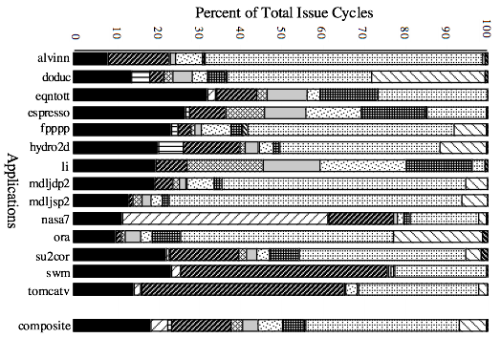
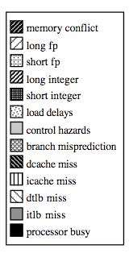
For most apps, most execution units lie idle
For an 8-way superscalar.
From: Tullsen, Eggers, and Levy,
“Simultaneous Multithreading: Maximizing On-chip Parallelism, ISCA 1995.

Slide 21
Performance beyond single thread ILP
There can be much higher natural parallelism in some applications (e.g., Database or Scientific codes)
Explicit Thread Level Parallelism or Data Level Parallelism
Thread: process with own instructions and data
thread may be a process part of a parallel program of multiple processes, or it may be an independent program
Each thread has all the state (instructions, data, PC, register state, and so on) necessary to allow it to execute
Data Level Parallelism: Perform identical operations on data, and lots of data
Is this Multiprocessor or Multi-core yet??

Slide 22
Thread Level Parallelism (TLP)
ILP exploits implicit parallel operations within a loop or straight-line code segment
TLP explicitly represented by the use of multiple threads of execution that are inherently parallel
Goal: Use multiple instruction streams to improve
Throughput of computers that run many programs
Execution time of multi-threaded programs
TLP could be more cost-effective to exploit than ILP

Slide 23
New Approach: Mulithreaded Execution
Multithreading: multiple threads to share the functional units of 1 processor via overlapping
processor must duplicate independent state of each thread e.g., a separate copy of register file, a separate PC, and for running independent programs, a separate page table
memory shared through the virtual memory mechanisms, which already support multiple processes
HW for fast thread switch; much faster than full context switch ≈ 100s to 1000s of clocks
When to switch?
Alternate instruction per thread (fine grain)
When a thread is stalled, perhaps for a cache miss, another thread can be executed (coarse grain)
Notes:
Similar to context switch but supported directly in hardware (no OS involvement)

Slide 24
Fine-Grained Multithreading
Switches between threads on each instruction, causing the execution of multiples threads to be interleaved
Usually done in a round-robin fashion, skipping any stalled threads
CPU must be able to switch threads every clock
Advantage is it can hide both short and long stalls, since instructions from other threads executed when one thread stalls
Disadvantage is it slows down execution of individual threads, since a thread ready to execute without stalls will be delayed by instructions from other threads
Used on Sun’s Niagara (will see later)

Slide 25
Course-Grained Multithreading
Switches threads only on costly stalls, such as L2 cache misses
Advantages
Relieves need to have very fast thread-switching
Doesn’t slow down thread, since instructions from other threads issued only when the thread encounters a costly stall
Disadvantage is hard to overcome throughput losses from shorter stalls, due to pipeline start-up costs
Since CPU issues instructions from 1 thread, when a stall occurs, the pipeline must be emptied or frozen
New thread must fill pipeline before instructions can complete
Because of this start-up overhead, coarse-grained multithreading is better for reducing penalty of high cost stalls, where pipeline refill << stall time
Used in IBM AS/400

Slide 26
Do both ILP and TLP?
TLP and ILP exploit two different kinds of parallel structure in a program
Could a processor oriented at ILP exploit TLP?
functional units are often idle in data path designed for ILP because of either stalls or dependences in the code
Could the TLP be used as a source of independent instructions that might keep the processor busy during stalls?
Could TLP be used to employ the functional units that would otherwise lie idle when insufficient ILP exists?

Slide 27
Simultaneous Multithreading (SMT)
Simultaneous multithreading (SMT): insight that dynamically scheduled processor already has many HW mechanisms to support multithreading
Large set of virtual registers that can be used to hold the register sets of independent threads
Register renaming provides unique register identifiers, so instructions from multiple threads can be mixed in datapath without confusing sources and destinations across threads
Out-of-order completion allows the threads to execute out of order, and get better utilization of the HW
Just adding a per thread renaming table and keeping separate PCs
Independent commitment can be supported by logically keeping a separate reorder buffer for each thread
Source: Micrprocessor Report, December 6, 1999 “Compaq Chooses SMT for Alpha”
Notes:
Variation of multithreading using multiple issue dynamic issue hardware approach.

Slide 28
Simultaneous Multi-threading ...
One thread, 8 units
Two threads, 8 units
Cycle
M
M
FX
FX
FP
FP
BR
CC
Cycle
M
M
FX
FX
FP
FP
BR
CC
1
2
3
4
5
6
7
8
9
1
2
3
4
5
6
7
8
9
M = Load/Store, FX = Fixed Point, FP = Floating Point, BR = Branch, CC = Condition Codes

Slide 29
Multithreaded Categories
Simultaneous
Multithreading
Time (processor cycle)
Superscalar
Fine-Grained
Coarse-Grained
Multiprocessing
Thread 1
Thread 3
Thread 5
Thread 2
Thread 4
Idle slot

Slide 30
Design Challenges in SMT
Since SMT makes sense only with fine-grained implementation, impact of fine-grained scheduling on single thread performance?
A preferred thread approach sacrifices neither throughput nor single-thread performance?
Unfortunately, with a preferred thread, the processor is likely to sacrifice some throughput, when preferred thread stalls
Larger register file needed to hold multiple contexts
Not affecting clock cycle time, especially in
Instruction issue - more candidate instructions need to be considered
Instruction completion - choosing which instructions to commit may be challenging
Ensuring that cache and TLB conflicts generated by SMT do not degrade performance
Notes:
SMT can be built on top of an out-of-order processor by adding a per-thread renaming table, separate program counter, multiple thread commit.

Slide 31
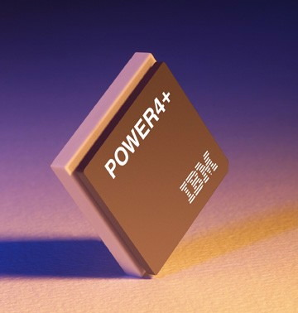
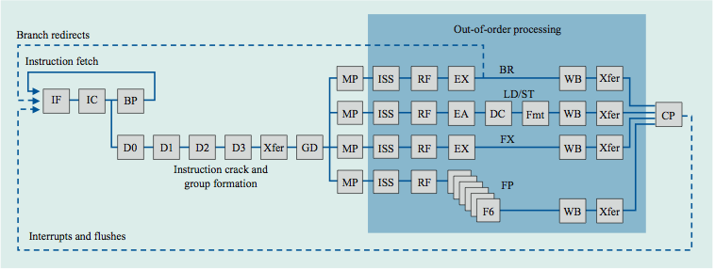
Power 4
Single-threaded predecessor to Power 5. 8 execution units in
out-of-order engine, each may
issue an instruction each cycle.
Notes:
The Power4 and Power5 are both dual core (Power4 first true duel core)

Slide 32
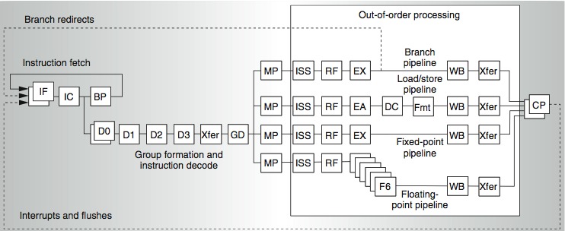
Power 4
2 commits (architected register sets)
Power 5
2 fetch (PC), 2 initial decodes

Slide 33
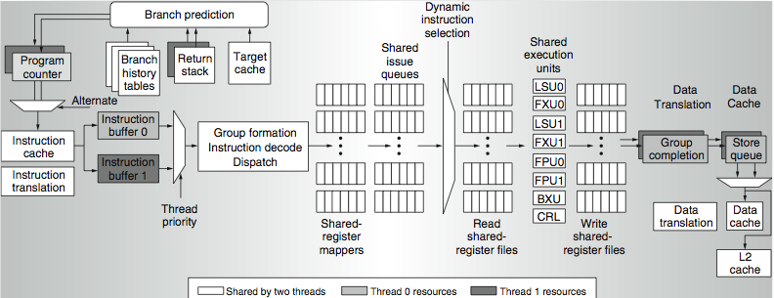
Power 5 data flow ...
Why only 2 threads? With 4, one of the shared resources (physical registers, cache, memory bandwidth) would be prone to bottleneck

Slide 34
Changes in Power 5 to support SMT
Increased associatively of L1 instruction cache and the instruction address translation buffers
Added per thread load and store queues
Increased size of the L2 (1.92 vs. 1.44 MB) and L3 caches
Added separate instruction prefetch and buffering per thread
Increased the number of virtual registers from 152 to 240
Increased the size of several issue queues
The Power5 core is about 24% larger than the Power4 core because of the addition of SMT support

Slide 35
Head to Head ILP/TLP competition
Processor | Micro architecture | Fetch / Issue / Execute | FU | Clock Rate (GHz) | Transis-tors Die size | Power
Intel Pentium 4 Extreme | Speculative dynamically scheduled; deeply pipelined; SMT | 3/3/4 | 7 int. 1 FP | 3.8 | 125 M 122 mm² | 115 W
AMD Athlon 64 FX-57 | Speculative dynamically scheduled | 3/3/4 | 6 int. 3 FP | 2.8 | 114 M 115 mm² | 104 W
IBM Power5 (1 core only) | Speculative dynamically scheduled; SMT; 2 CPU cores/chip | 8/4/8 | 6 int. 2 FP | 1.9 | 200 M 300 mm² (est.) | 80W (est.)
Intel Itanium 2 | Statically scheduled VLIW-style | 6/5/11 | 9 int. 2 FP | 1.6 | 592 M 423 mm² | 130 W

Slide 36
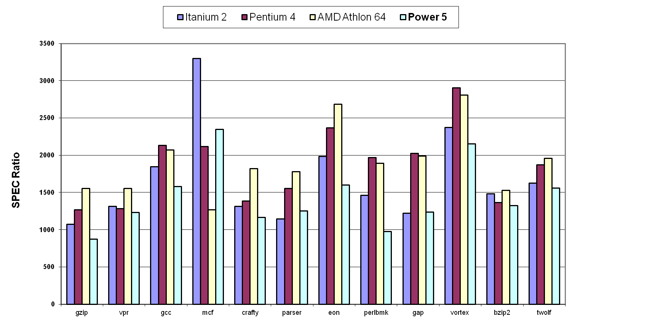
Performance on SPECint2000
Notes:
No clear dominant winner. Itanium and Power5 seem to lead in FP benchmarks while Athlon and Pentium4 seem to outperform on INT benchmarks – SO what should I buy.

Slide 37
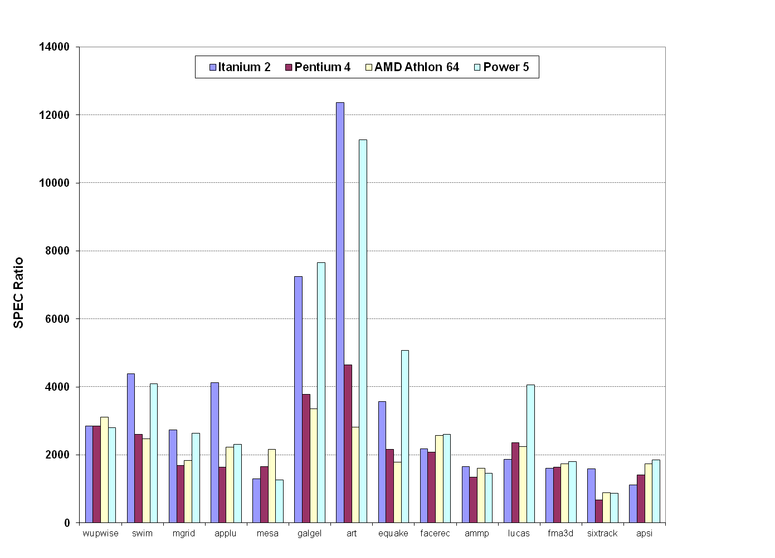
Performance on SPECfp2000

Slide 38
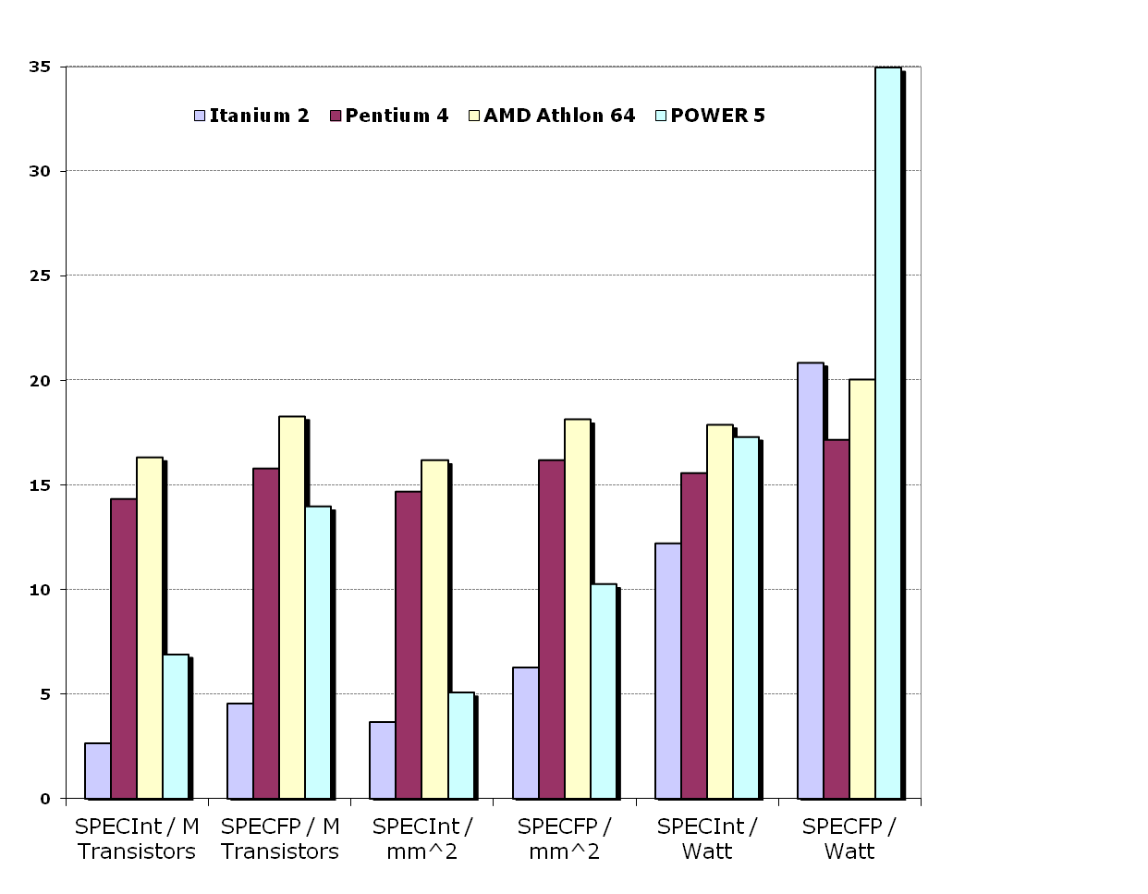
Normalized Performance: Efficiency
Rank | I tanium2 | Pen t I um4 | A t h l on | Powe r 5
Int/Trans | 4 | 2 | 1 | 3
FP/Trans | 4 | 2 | 1 | 3
Int/area | 4 | 2 | 1 | 3
FP/area | 4 | 2 | 1 | 3
Int/Watt | 4 | 3 | 1 | 2
FP/Watt | 2 | 4 | 3 | 1
Notes:
One last comparison

Slide 39
No Silver Bullet for ILP
No obvious over all leader in performance
The AMD Athlon leads on SPECInt performance followed by the Pentium 4, Itanium 2, and Power5
Itanium 2 and Power5, which perform similarly on SPECFP, clearly dominate the Athlon and Pentium 4 on SPECFP
Itanium 2 is the most inefficient processor both for Fl. Pt. and integer code for all but one efficiency measure (SPECFP/Watt)
Athlon and Pentium 4 both make good use of transistors and area in terms of efficiency,
IBM Power5 is the most effective user of energy on SPECFP and essentially tied on SPECINT

Slide 40
Limits to ILP
Most techniques for increasing performance increase power consumption
The key question is whether a technique is energy efficient: does it increase power consumption faster than it increases performance?
Multiple issue processors techniques all are energy inefficient:
Issuing multiple instructions incurs some overhead in logic that grows faster than the issue rate grows
Growing gap between peak issue rates and sustained performance
Number of transistors switching = f(peak issue rate), and performance = f( sustained rate), growing gap between peak and sustained performance ⇒ increasing energy per unit of performance

Slide 41
Commentary
Instead of pursuing more ILP, architects are increasingly focusing on TLP implemented with single-chip multiprocessors ⇒ Multicores
In 2000, IBM announced the 1st commercial single-chip, general-purpose multi-core, the Power4, which contains 2 Power3 processors and an integrated L2 cache
Since then, Sun Microsystems, AMD, and Intel have switch to a focus on single-chip multiprocessors/multi-cores rather than more aggressive uniprocessors.
Right balance of ILP and TLP is unclear today
Perhaps right choice for server market, which can exploit more TLP, may differ from desktop, where single-thread performance may continue to be a primary requirement

Slide 42
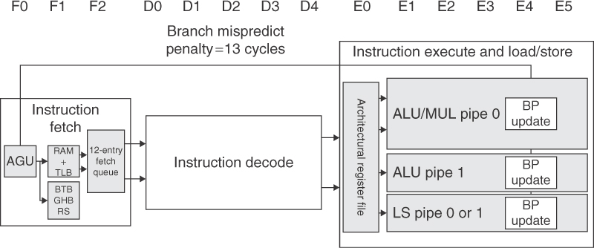
ARM Cortex 8
Dual Issue, statically scheduled, dynamic issue detection
Max CPI: .5
13-stage pipeline

Slide 43
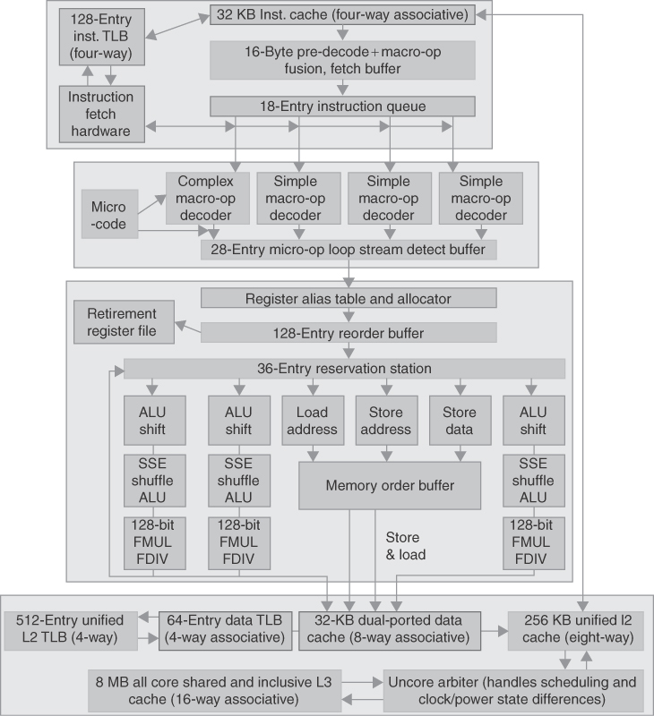
Intel Core i7
Aggressive Out-of-order multiple issue with speculation
14 stage pipeline
Branch penalty: 17 cycles

